Slide 1
Querying DNS for software updates
Mechiel Lukkien
mechiel@ueber.net
https://github.com/mjl-

Slide 2
Agenda
Part 1:
  Updates through DNS, manually
  Automating DNS for Go with gopherwatch.org
Part 2:
  Automating upgrades with ysco
  On-demand binaries with beta.gobuilds.org

Slide 3
  Updates through DNS, manually
$ dig +short TXT _updates.xmox.nl
"v=UPDATES0;l=v0.0.15"
Release involves updating DNS record

Slide 4
  DNS is a good fit
Low overhead
DNS caching, redundant servers
Can’t track exact installations/IP’s

Slide 5
Automate DNS records for Go ecosystem
All Go software is in a transparency log (tlog) called Go sumdb
  modules and semver versions and hashes of source code
  Git tags like v0.1.2, also pseudo-versions for commits
Gopherwatch.org was already monitoring the tlog and building database, just needed a DNS server

Slide 6
Example for github.com/mjl-/mox
$ dig +short TXT mox.mjl_2d._.github.com.v0.l.gopherwatch.org
"v=v0.0.15 t=6802a84d"
.gopherwatch.org
.l
.v0
.github.com
._
.mjl_2d
mox

Slide 7
Example for Go toolchain
$ dig +short TXT toolchain.v0.l.gopherwatch.org
"v=go1.25.6 k=cur t=69693421; v=go1.24.12 k=prev t=69693421; v=go1.26rc2 k=next t=69693421"

Slide 8
Gopherwatch DNS server
Built with github.com/miekg/dns
<1000 lines of extra Go code
DNSSEC with online signing and compact denial of existence

Slide 9
How the Go sumdb gets filled
Go toolchains request “latest” source code through Go module proxy
  “go install github.com/mjl-/mox@latest”
  Use external library and “go get”
  “Latest” is resolved and new entries added to tlog

Slide 10
To do
Add second DNS server to l.gopherwatch.org for redundancy
Test/fuzz the DNS request handling. Tips for test suites?
Responses with tlog proofs, and verifiable indexes.

Slide 11
Part 2
Automating upgrades with ysco
On-demand binaries with beta.gobuilds.org

Slide 12
Automating upgrades with ysco
“./mygosvc” → “ysco run ./mygosvc”
DNS query for updates every 24h
  Also query for new Go toolchains (static linking)
Upgrade (download, terminate & restart):
  One-click, through web interface
  Automatic: delayed, policy (patch/minor), schedule
No modifications to applications needed!

Slide 13
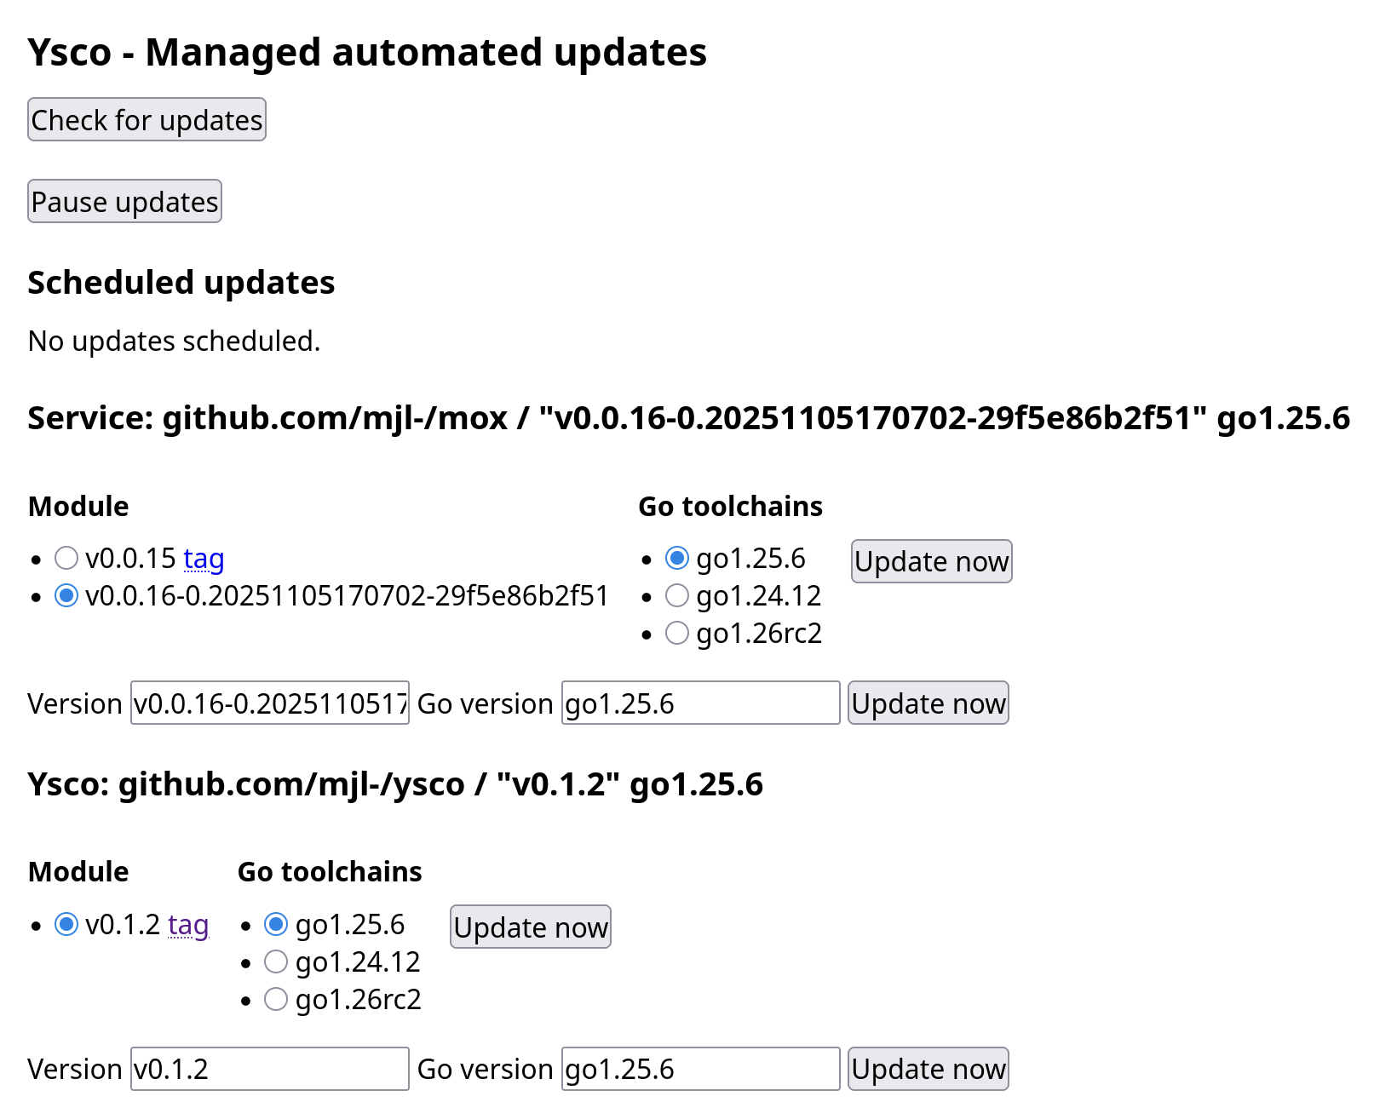

Slide 14
beta.gobuilds.org
Service that compiles Go source on-demand
  Source code(*) is verified through Go sumdb (tlog)
  Automatically downloads new (verified) Go toolchains
Cross-compiled for any OS/arch
Reproducible builds (verified against 2nd server)
Adds hashes of binaries to its own tlog
Go toolchain only runs its own code to build, none of the project being compiled

Slide 15
https://beta.gobuilds.org

Slide 16
Summary
One-click or fully automated upgrades from Go source, without changes to applications
Find updates for all Go software over DNS
Use ysco to easily upgrade any Go service
Using beta.gobuilds.org to compile on-demand

Slide 17
More
https://github.com/mjl-/gopherwatch
https://github.com/mjl-/ysco
https://github.com/mjl-/gobuild
https://www.ueber.net/who/mjl/blog/p/ysco-managed-automated-updates-for-go-services/

